Slide 1

Rajiv Gandhi University of Knowledge and Technologies,Srikakulam
Department of Computer Science and Engineering
Mini project-1
Enhanced Outpass Security with
Facial Recognition
Project Guide:
Mrs.Ch.Lakshmi Bala madam
Assistant professor
CSE department
Batch :55
1.S.Surya Prakash (S191072)
2.R.Sai Niharika(S190342)
3.K.Vanitha(S190369)
4.M.Lakshmi Divya (S190185)

Slide 2

CONTENTS:
1. Abstract
2. Objective
3. Introduction
4. Problem Statement
5. Existing system
6. Proposed System
7. Input data
8.Technologies used
9.Applications
10. References
11. Conclusion

Slide 3
ABSTRACT
The Enhanced outpass security with facial recognition transforms outpass management by advanced facial recognition technology. This system not only streamlines the issuance process but also significantly improves security measures within organizations. By automating the verification of individuals seeking permission to leave premises, it minimizes errors and enhances operational efficiency. Furthermore, the system maintains detailed records of outpass transactions, providing administrators with valuable insights for auditing. Its real-time monitoring capabilities ensure prompt responses to outpass requests, thereby improving overall safety protocols. The integration of facial recognition technology offers a continuous user experience, enabling quick and secure identification of individuals. Overall, the Enhanced outpass security with facial recognition represents important advancement in organizational security, enhancing both administrative efficiency and safety standards effectively by using face recognition algorithms.

Slide 4
OBJECTIVE
Our project, the "Enhanced outpass security with facial recognition”, aims to standardize the process of taking university outpasses. Traditional methods are often manual, time-consuming, and prone to errors, leading to inefficiencies and delays. By integrating advanced facial recognition technology, our system ensures accurate verification of individuals seeking permission to leave campus. Moreover, the system is designed to enhance security by preventing unauthorized access and maintaining detailed records of outpass transactions. In addition to streamlining the issuance and verification processes, our project emphasizes user convenience and seamless integration with existing university systems. It aims to create a user-friendly interface that simplifies the outpass application process, thereby reducing administrative burden and improving overall campus management. Ultimately, our goal is to transform how universities manage outpasses, making the process more efficient, secure, and reliable for students, faculty, and administrative staff alike.

Slide 5
INTRODUCTION
The Traditional outpass management process within our campus relies heavily on manual paperwork, resulting in a time- consuming procedure for both students and wardens or Caretakers. The existing system lacks efficiency, often leading to delays in the approval process and potential errors in documentation. The current paper-based approach involves students physically submitting outpass requests, which are then manually processed by administrative staff. This process not only consumes valuable time but also poses challenges in terms of record keeping, tracking, validating the student and maintaining the security of sensitive information. Recognizing the limitations of the current system, there is a need for a modern and technologically advanced solution that can overcome these challenges and bring about a positive transformation in the way outpasses are managed within our campus.

Slide 6
PROBLEM STATEMENT
The existing manual outpass system in academic institutions presents security and efficiency challenges. To tackle this issue, we are introducing “Enhancing outpass security with face recognition". This initiative aims to enhance the process of student outpass requests by cross-referencing them with their parent's information, verifying identities accurately through facial recognition, and enabling real-time monitoring for Wardens. The ultimate goal of this system is to transform campus security by providing a secure and effective method for tracking student whereabouts on the premises.

Slide 7
EXISTING SYSTEM
In traditional outpass management systems, the process is often manual and time-consuming. Security personnel or administrative staff typically handle the issuance of outpasses, relying on identification cards and manual record-keeping. This approach can lead to errors, delays, and increased workload. The lack of a reliable verification mechanism may also compromise security. Existing outpass management system with facial recognition enables only students to recognize their faces and get outpass without parent arrival to the campus. System does not work for girl students at all as it work for male students. It asks for the student also when he/she returns from the leave .
Existing system disadvantages:
1.Existing system only applicable for male students for whom parents are not required to come but it doesn't work for female students in our campus as the system don't have face recognition access.
2.Algorithm of face recognition is not working well with few changes in the lightning environment and facial changes.
3. Existing system also lack the identification of the student coming to the campus after taking the leave .

Slide 8
PROPOSED SYSTEM
The proposed "Enhanced outpass security with facial recognition" addresses inefficiencies and security concerns of traditional manual outpass systems. It features two main components: a caretaker module and a main gate module, both equipped with facial recognition
1.Caretaker module:
Student face capture: The caretaker captures the student’s face using a camera.
Verification: The system verifies the captured image against the student database. If matched, the system prepares the outpass details.
Issuance of Outpass: Upon successful verification of both student and parent, the outpass is issued.
2. Main Gate Module:
Parent Face Capture: At the main gate, the security personnel capture the parent’s face
.
Verification: The system checks the parent’s face against the registered database. If matched, the outpass is validated.
This system enhances security by requiring dual verification, reduces administrative workload through automation, and ensures accuracy, efficiency, and convenience in the outpass issuance process.

Slide 9
INPUT DATA
The proposed face recognition system works on known faces and compare them with unknown faces . Input data contains faces of students and their parents stored according to their ID numbers and relations with the concerned parents . Along with this, the system also takes another input data .
Student_details.csv - It is a comma separated values file which stores student details like student name,student ID,parents names.
It also stores multiple users data - Main gate security,warden office

Slide 10
TECHNOLOGIES USED
This project use a specific algorithms in face recognition library. The system is developed by a library called “Face_recognition” .This library contains three specific algorithms
1.Face detection - This algorithm can identify the face locations of human faces in the images
2.Face encoding - For each detected image ,it generates numerical representations . The encoding capture
features like distance between eyes , shape of the jawline
3.Face recognition - By using face encoding it can determine if two faces belong to the same person.

Slide 11
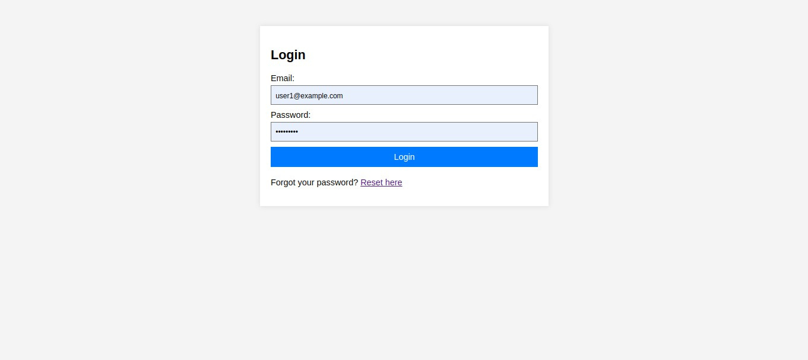
login page

Slide 12
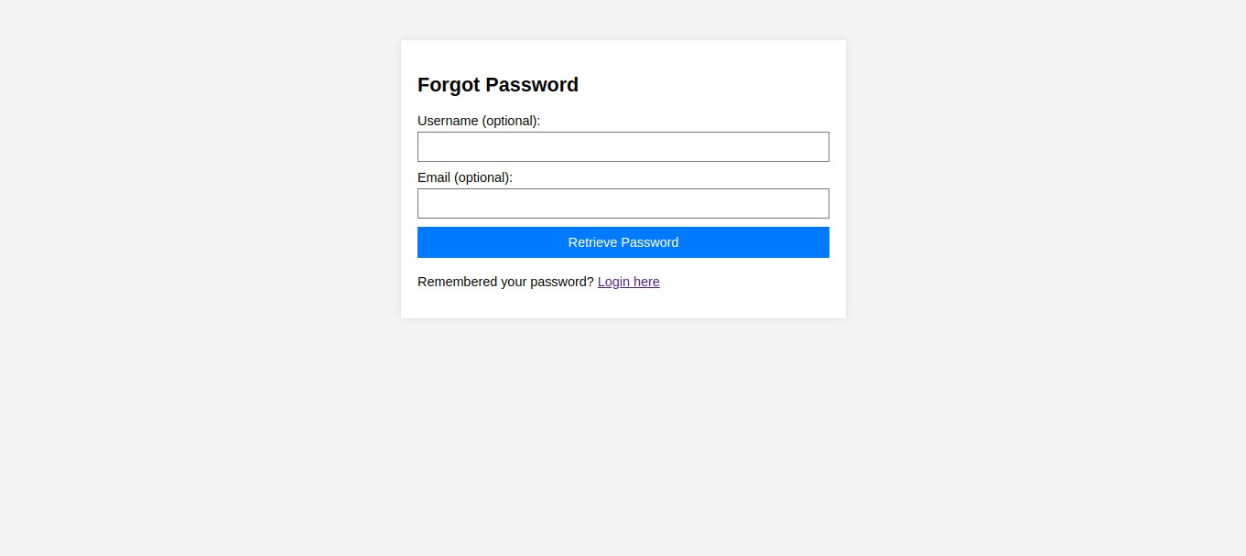
If user forget password

Slide 13
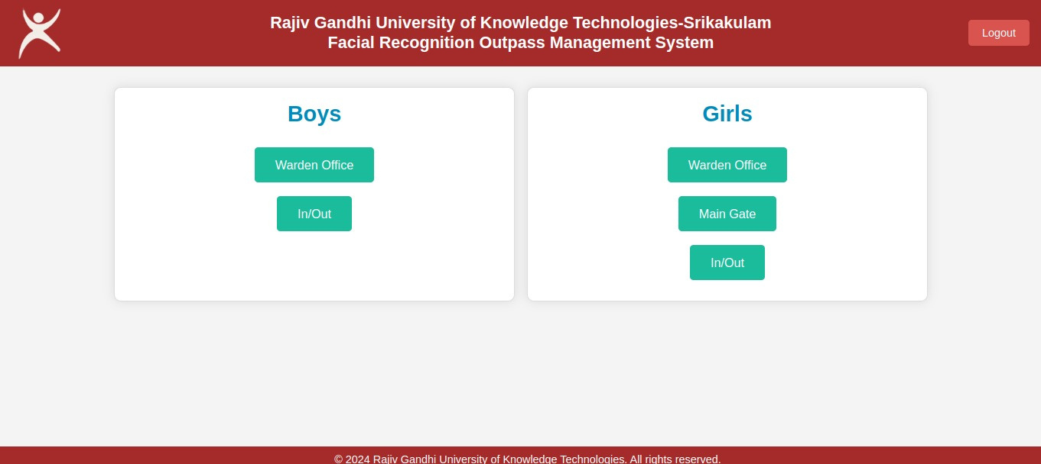

Else
home page: if student is a boy

Slide 14
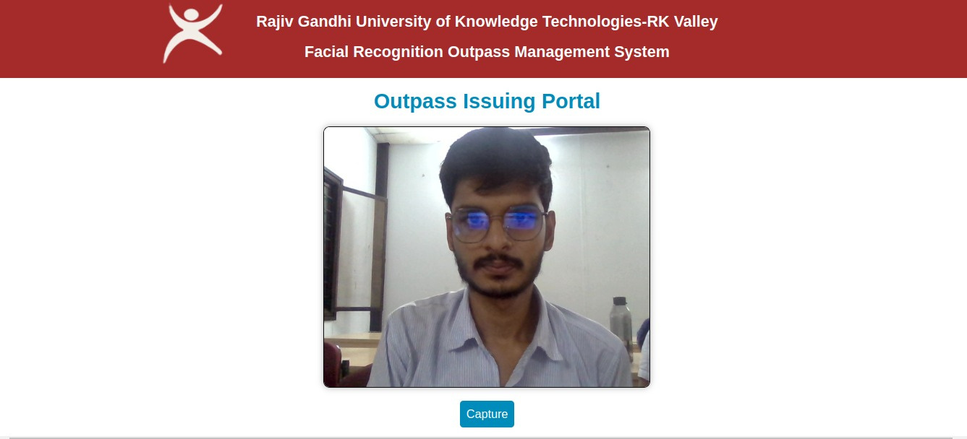

Slide 15
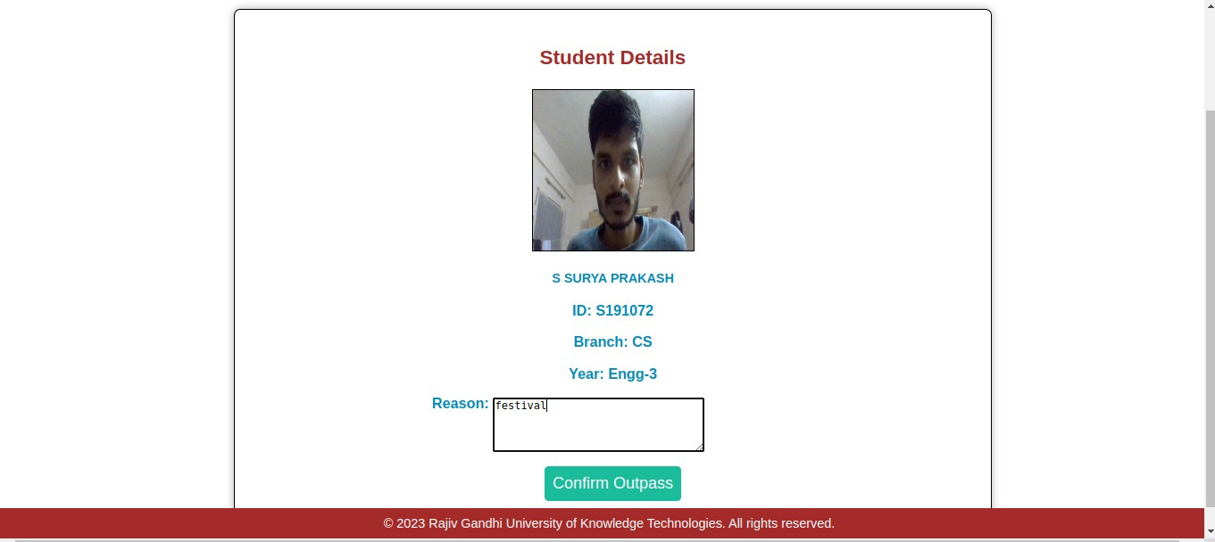

Slide 16
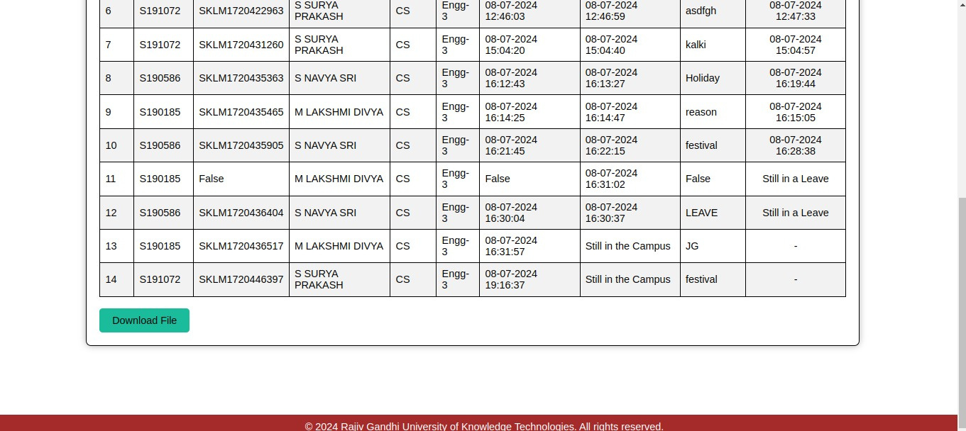
Appends the update

Slide 17
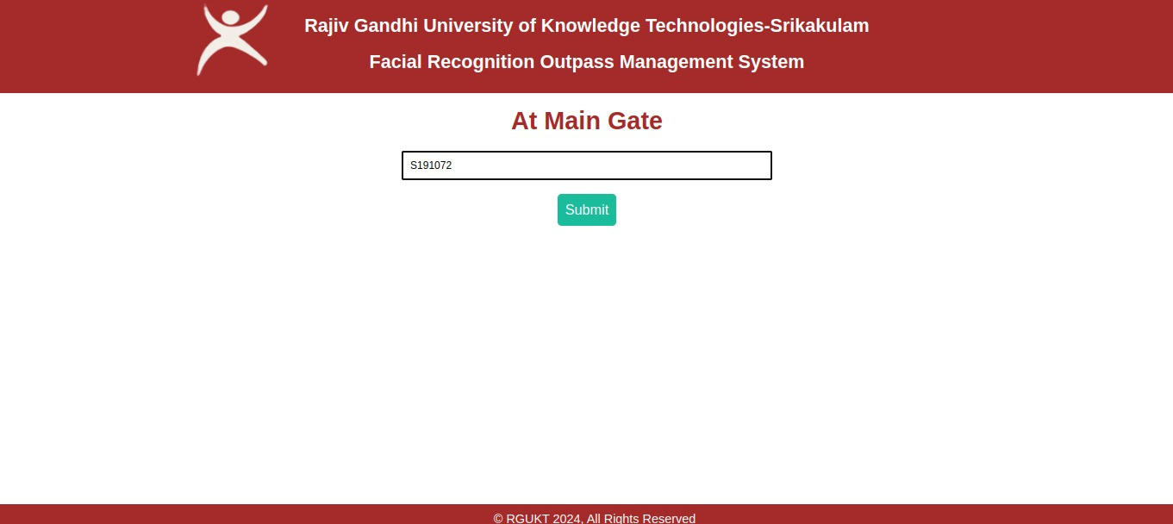
Him leaving from campus through main gate

Slide 18
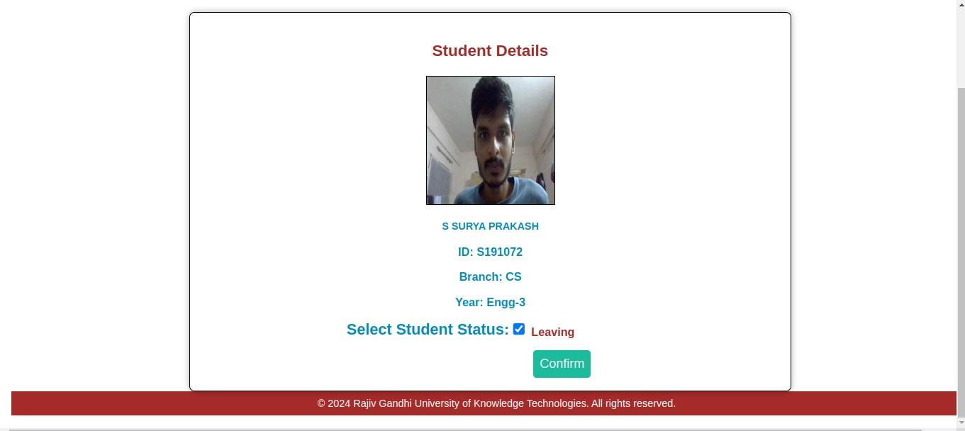

Slide 19

Him leaving the campus

Slide 20
Him entering into campus

Slide 22


Slide 23

His total leave update is stored along with date of arrival ,date of leaving

Slide 24
Home page: if student is a girl

Slide 25
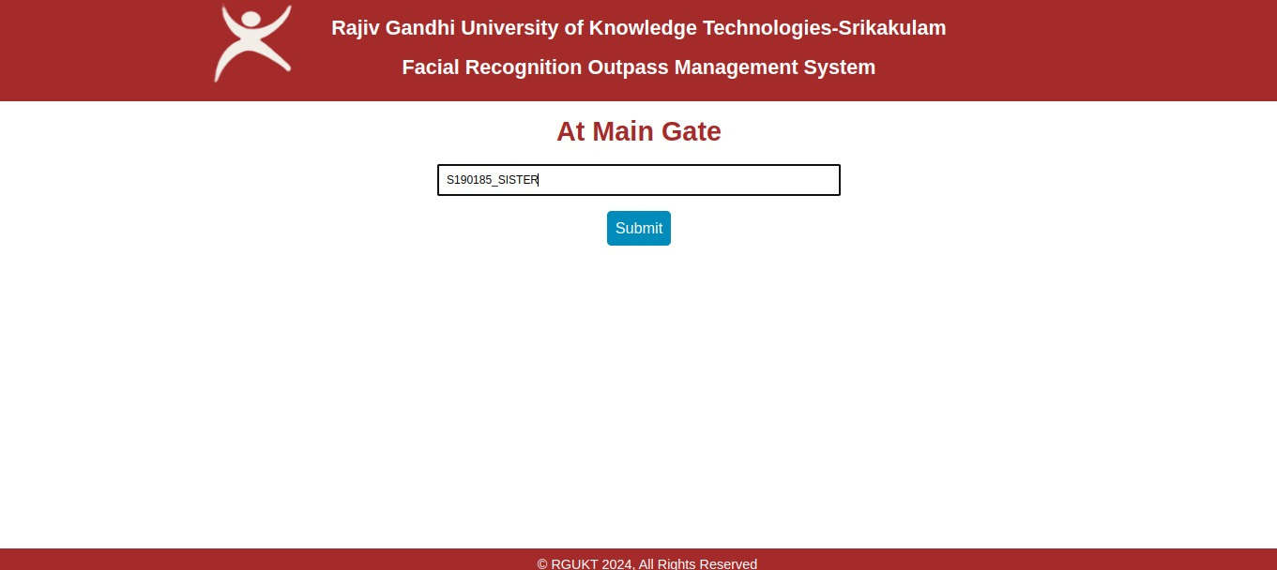
For a girl student concerned parent should arrive

Slide 26
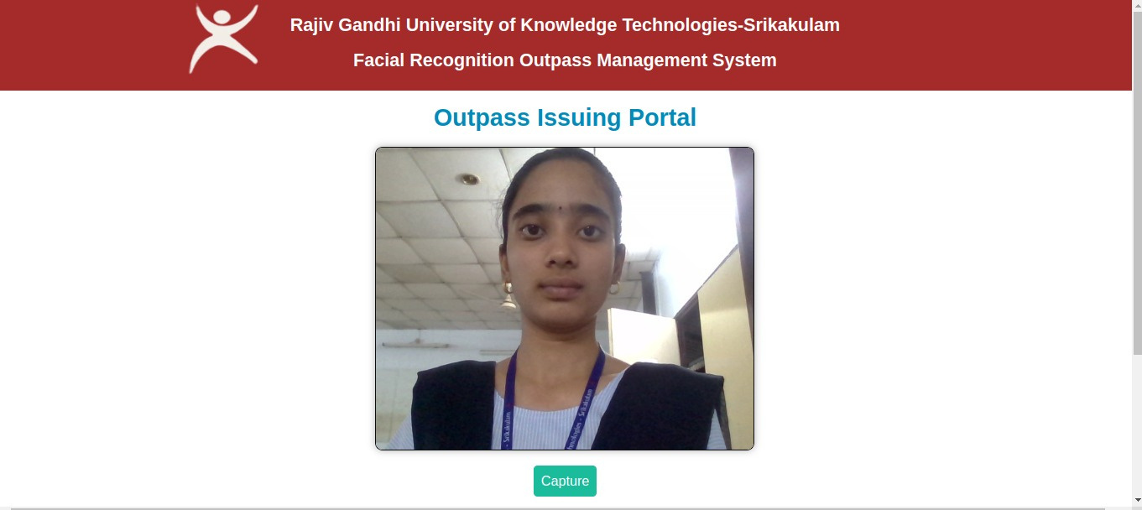

Slide 27
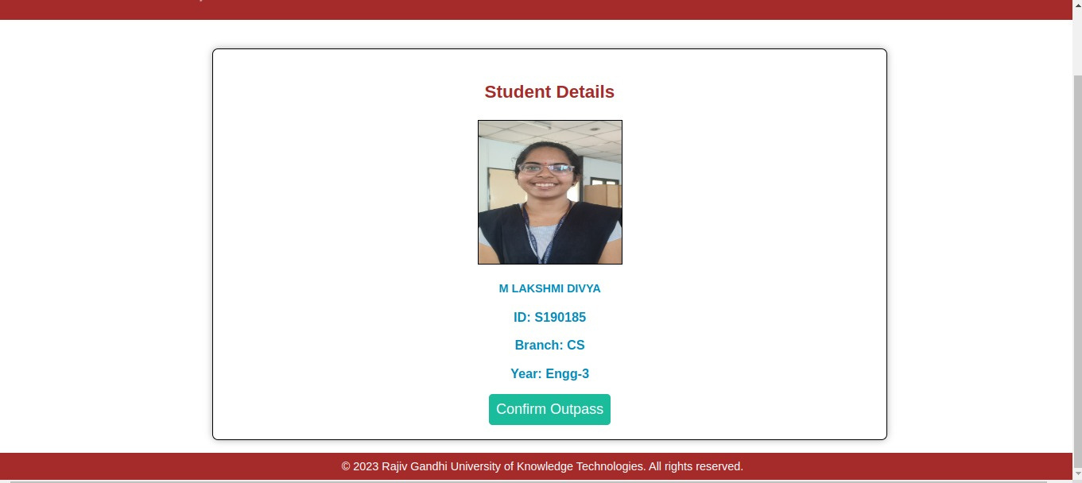
Student data related to concerned person will appear

Slide 28
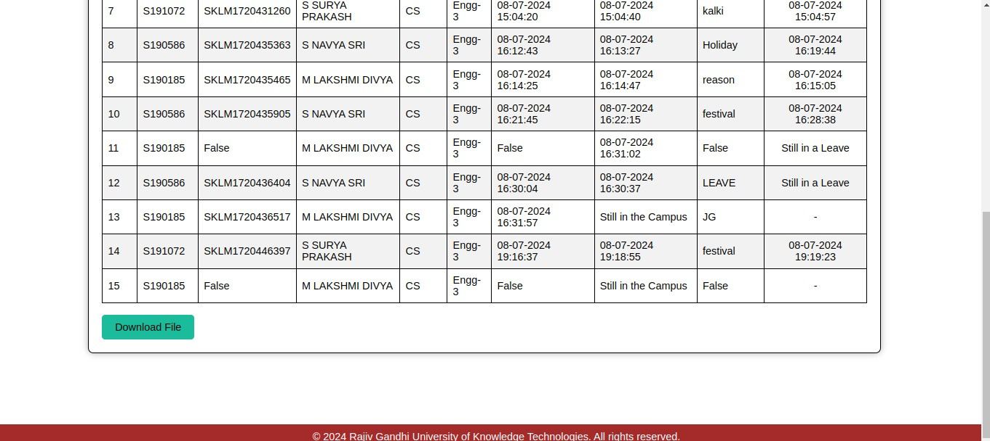
List will be updated

Slide 29
Girl student at warden office

Slide 30


Slide 31
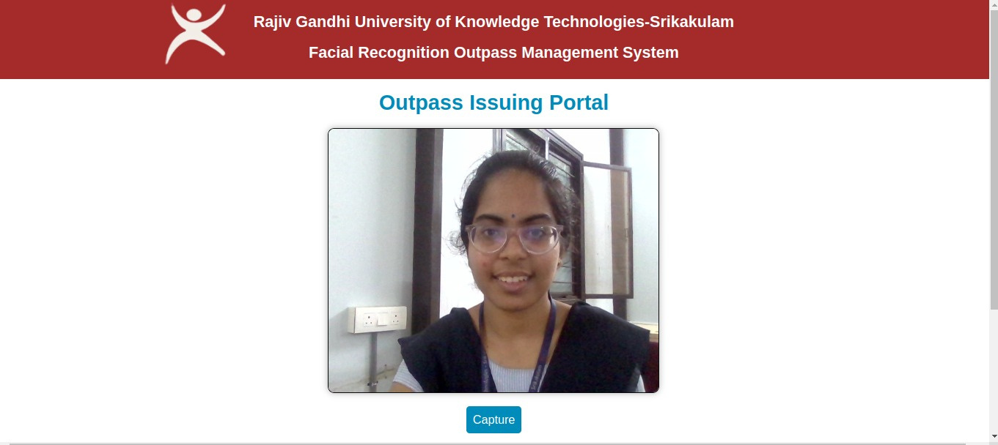

Slide 32
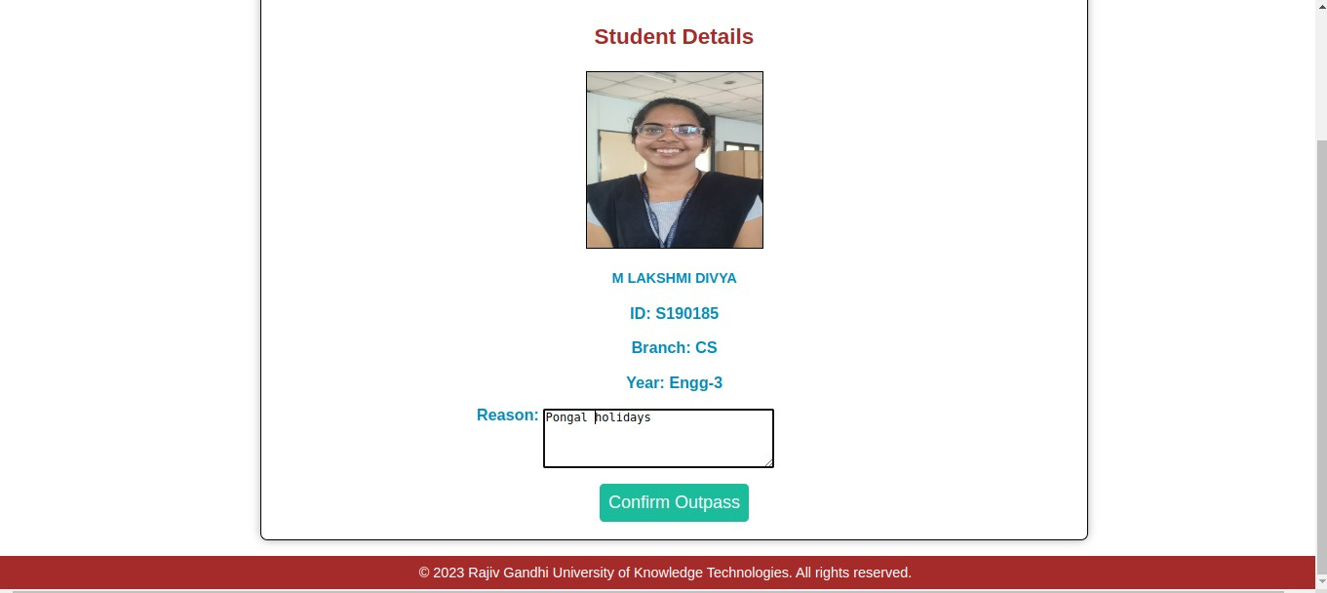

Slide 33
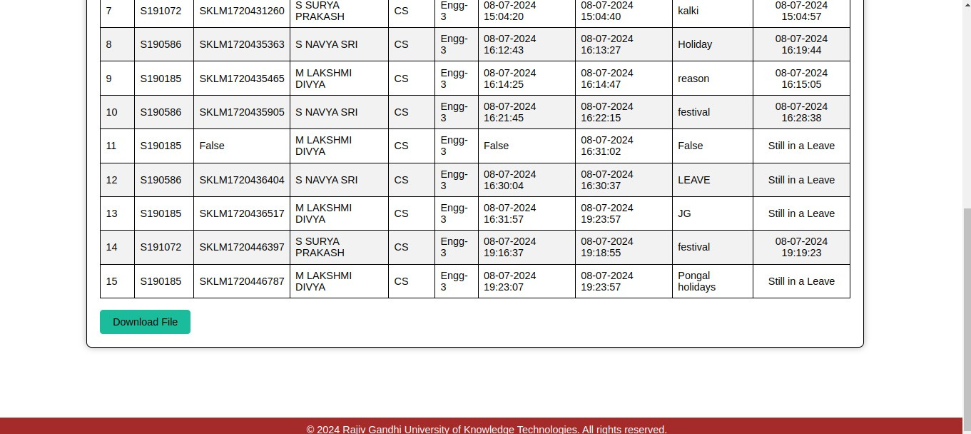

Slide 34
Girl student reaching the main gate

Slide 35
Girl student leaving the campus

Slide 36
Girl student leaving the campus

Slide 37
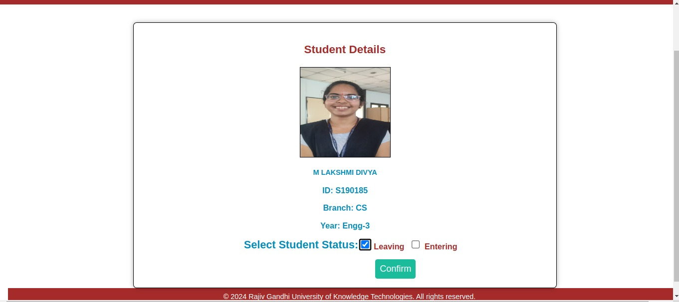
Girl student leaving the campus

Slide 38
Girl student leaving the campus

Slide 39
Girl student returning to the campus

Slide 40
Girl student returning to the campus

Slide 41
Face recognition at the main gate after entering into campus

Slide 42
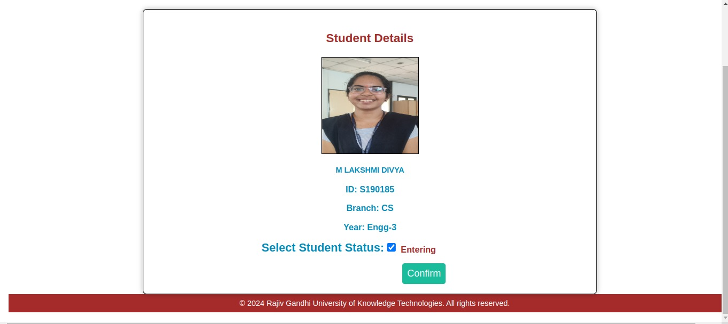
Leave details will be updated

Slide 43

Leave details will be updated

Slide 44
APPLICATIONS
An Outpass Management System with facial recognition has numerous applications across various sectors, particularly in institutions and organizations where tracking and managing the movement of individuals is crucial. Here are some key applications:
1. Educational Institutions:
1.1 Hostels: Automate the process of issuing outpasses for students. Facial recognition ensures that only authorized students can request and receive outpasses, enhancing security and streamlining administrative tasks
1.2 Campus Security: Improve campus security by monitoring student movements in and out of campus premises. Facial recognition can help verify student identities at entry and exit points.
1.3. Attendance Tracking: Integrate with class attendance systems to manage and monitor student attendance more efficiently.
2. Healthcare Facilities: For monitoring patient and staff movements, ensuring compliance with health protocols, and enhancing the safety of healthcare environments.
3. Residential Complexes: For managing resident and visitor access, improving security, and providing residents with a convenient way to request and manage outpasses.
4. Events and Conferences: For efficient attendee management, controlling access to VIP areas, and enhancing event security.

Slide 45
CONCLUSION
The proposed Enhanced outpass security with facial recognition proves significant improvements in accuracy and efficiency for the outpass issuance process. With high recognition rates exceeding 80% on the evaluation dataset, the system ensures reliable verification of both student and parent identities, effectively addressing the drawbacks of manual verification. By integrating facial recognition technology with a streamlined interface and using CSV files for data storage, the system enhances the speed and convenience of issuing outpasses. Automation reduces administrative overhead by eliminating paperwork and manual documentation. Real-time tracking of student movements through detailed outpass logs enables improved monitoring and attendance analysis. Overall, the system modernizes traditional paper-based administration in educational institutions, increasing transparency, tightening security, and reducing workload. The dual verification process involving both student and parent which is an added advantage to the existing system. Continued refinement and feature expansion will further enhance its potential for deployment across academic campuses.

Slide 46
REFERENCES
[1] Menon, S., Geroge, A., Aswathy, N., & James, J. (2021, May). Custom Face Recognition Using YOLO. V3. In 2021 3rd International Conference on Signal Processing and Communication (ICPSC) (pp. 454458). IEEE.
[2] Yang, H., & Han, X. (2020). Face recognition attendance system based on realtime video processing. IEEE Access, 8, 159143159150

Slide 47
THANK YOU

